Slide 1

Solar harvest
CINTEZA EMILIAN-COSMIN

Slide 2
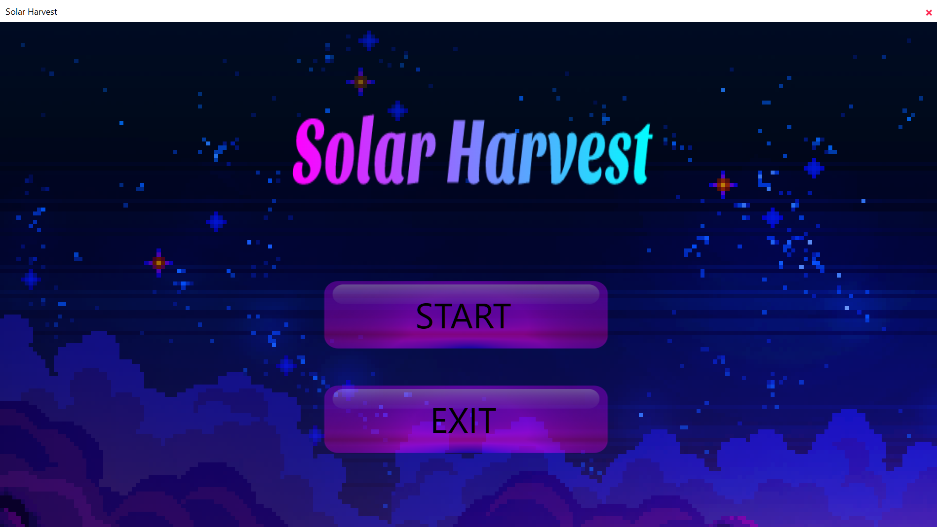
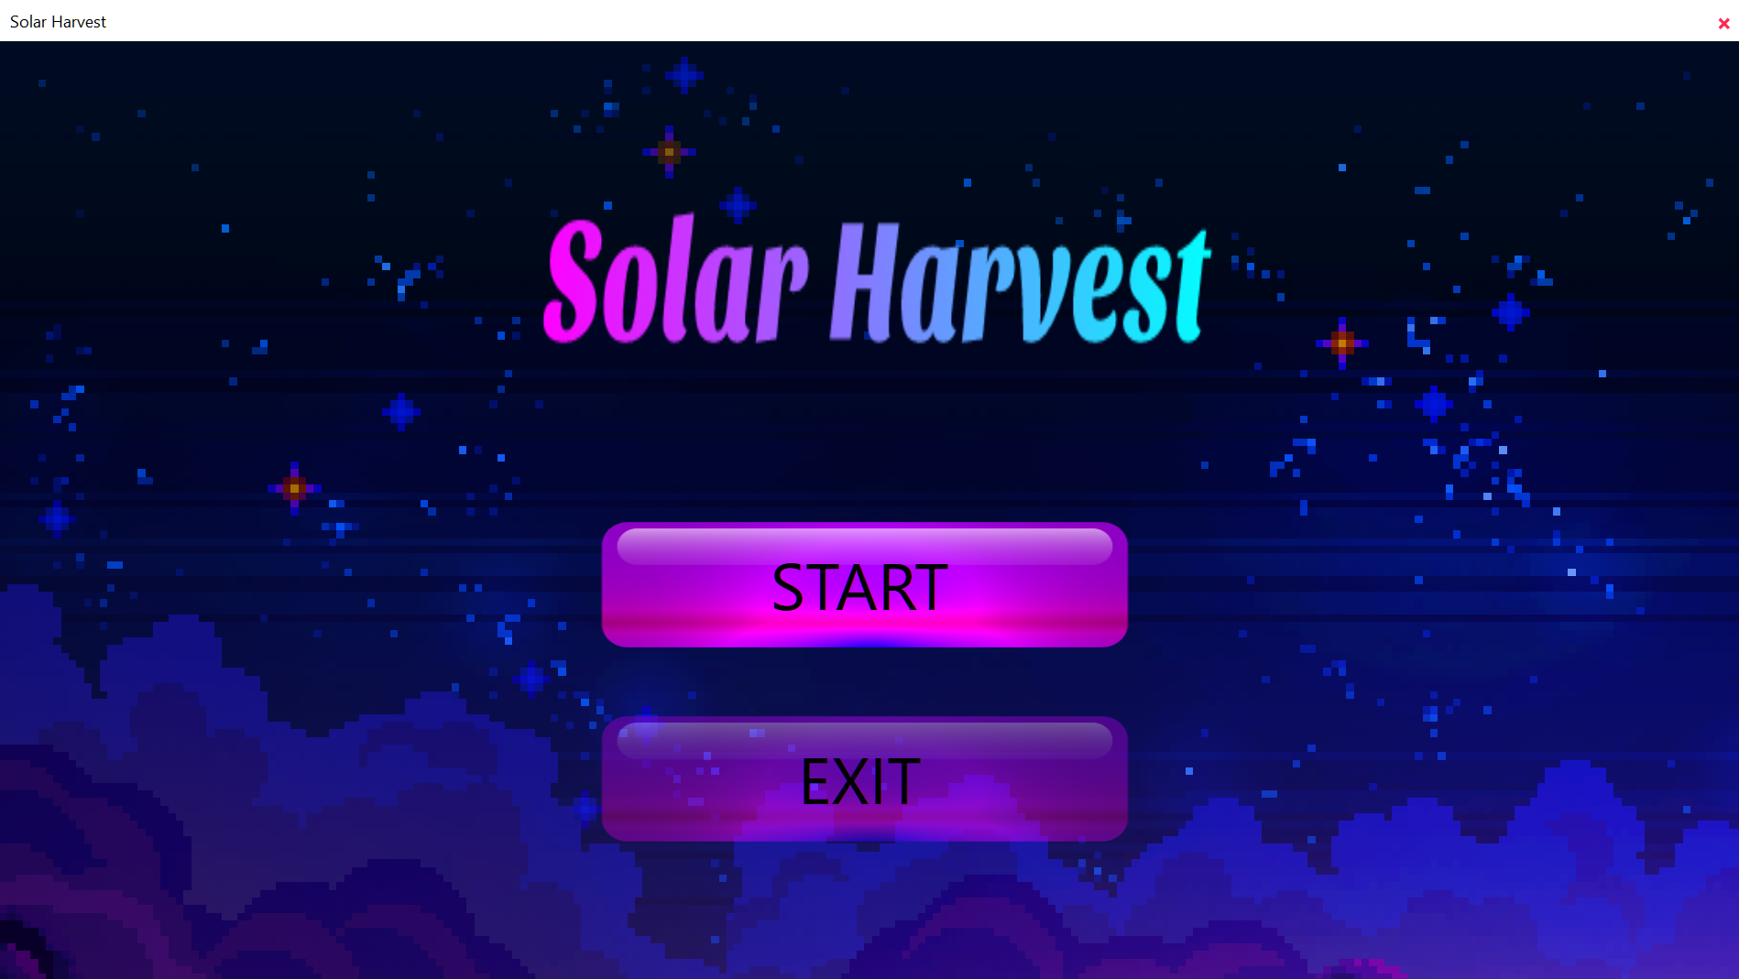
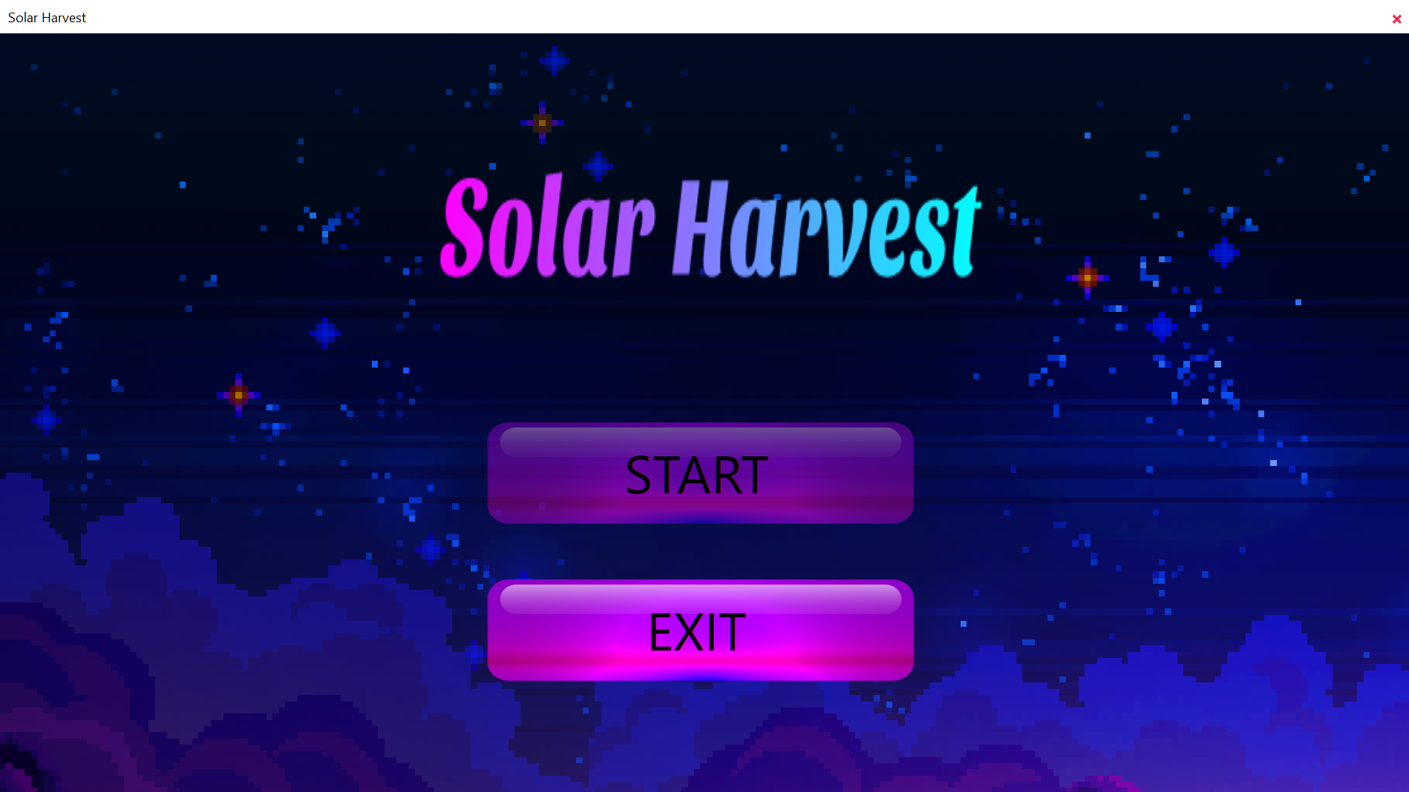
Start Screen
First time when you open the game, you will enter in the start screen that is the main screen of the game.
The background music will start after the immediate run of the game.
In this menu you can either press Start to enter the Map & Hero selection or Exit the game.
When you hover over any button in the game, in the Main, Selection and Game windows, it will light up, making you aware of which button your mouse arrow is over.

Slide 3
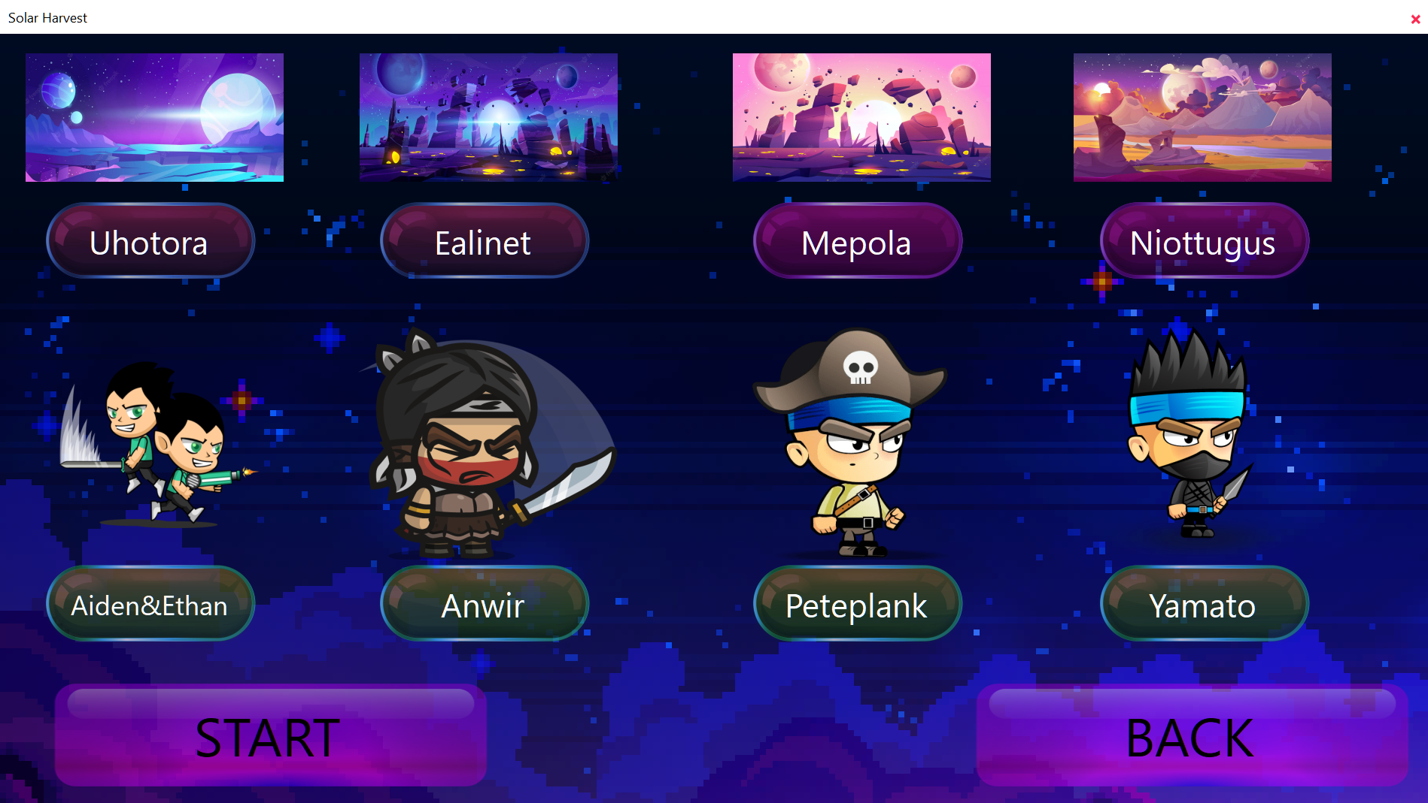
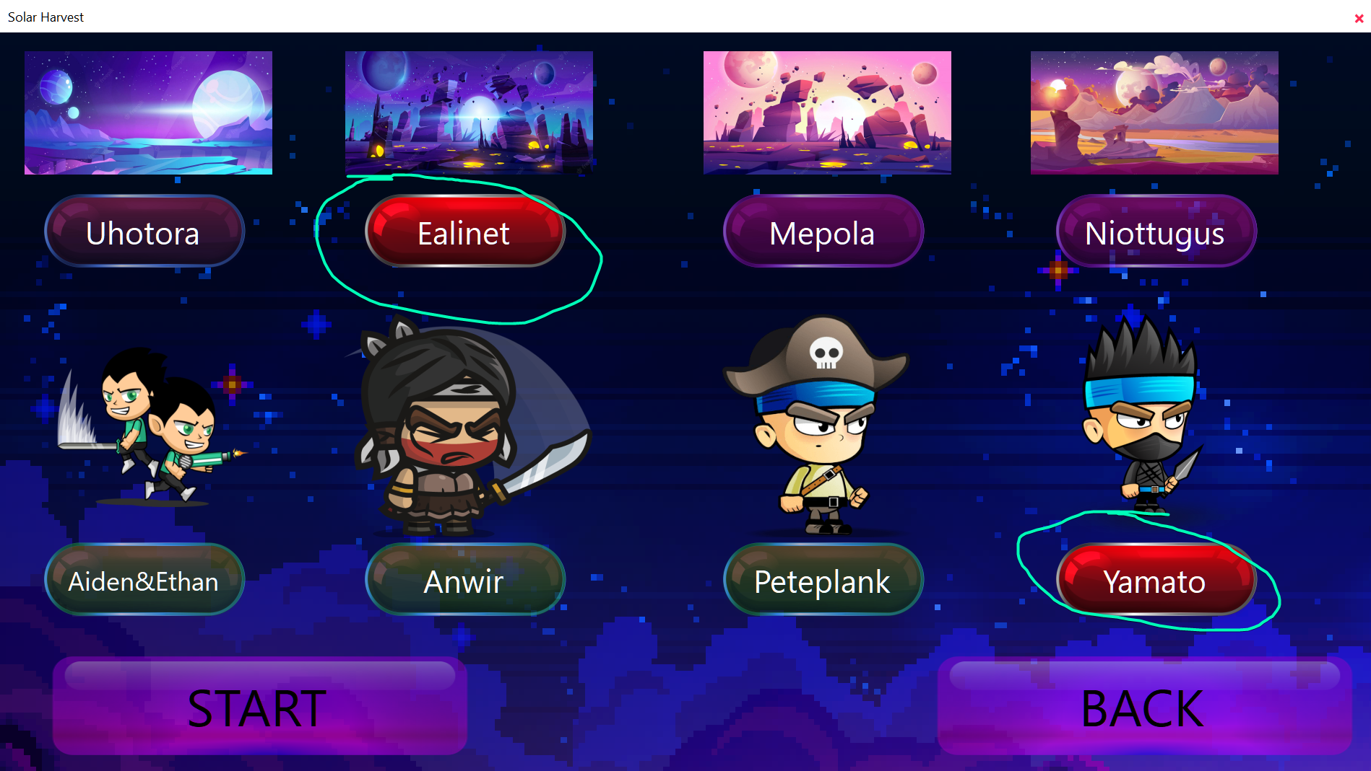
Map & Character Selection
In this menu you will have 10 buttons, 4 for the maps and 4 for the characters.
After choosing a map/character the button will become red making you aware of your selections and will stay in a solid state.

Slide 4
Map & Character Selection
You will not be able to press start until there has been a map selected and a character selected to start the game.
After choosing your characters and you press Start, the game music will stop.
You can change your selections if you have changed your mind and want to play with a different character or a different map.

Slide 5
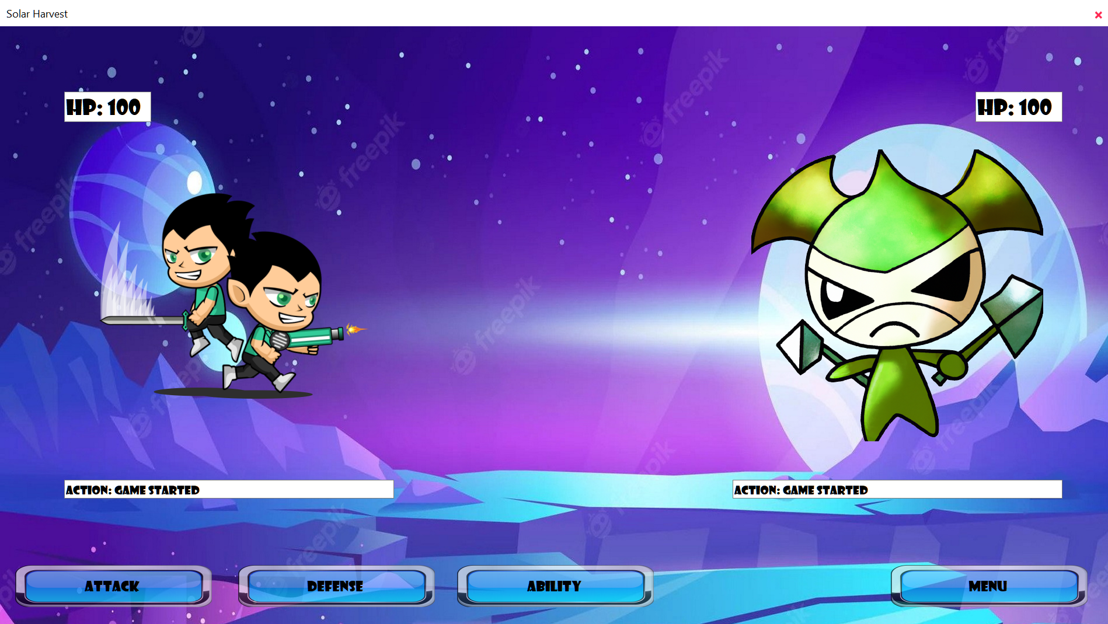
Game Screen
After pressing start in the
selection menu you will
hear a “sword hit” sound
then the game window will appear. After the game has started, your character will be on the right and the enemy on the left, each one with their own hp above and action text underneath.

Slide 6
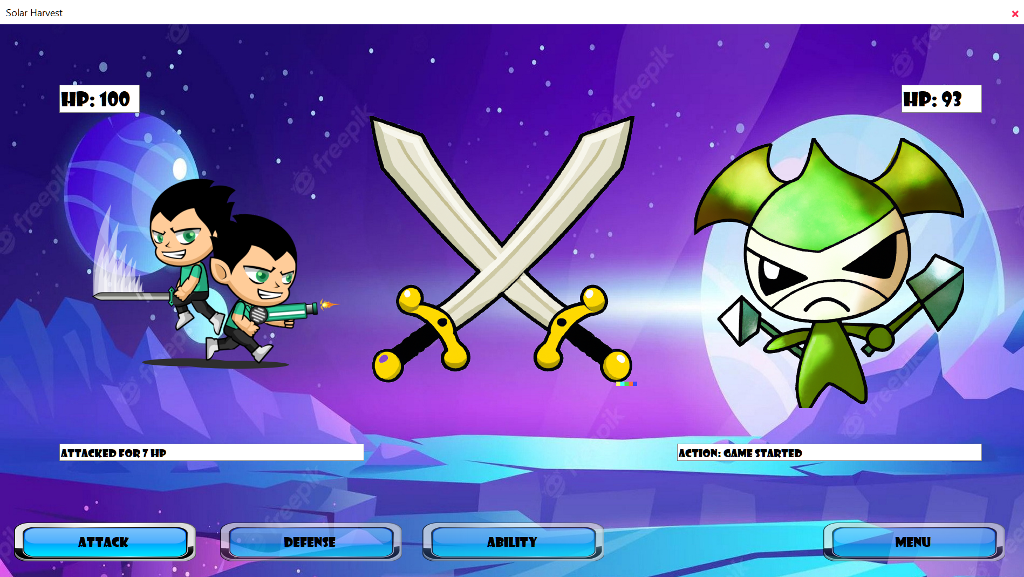
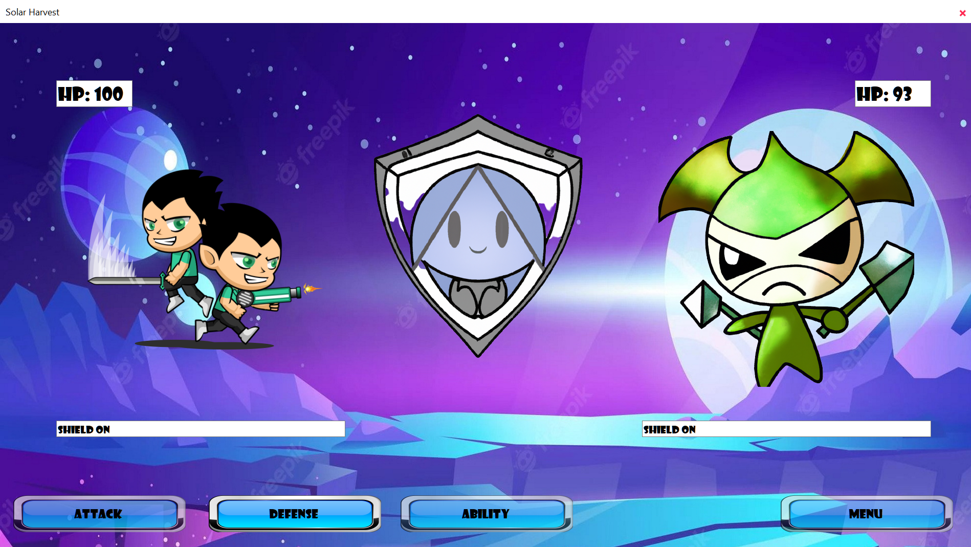
Actions
Each action button has its own sound and it’s own Action Text and Action Picture.
After any of the action buttons is pressed, each one has it’s own unique sound, text and picture.

Slide 7
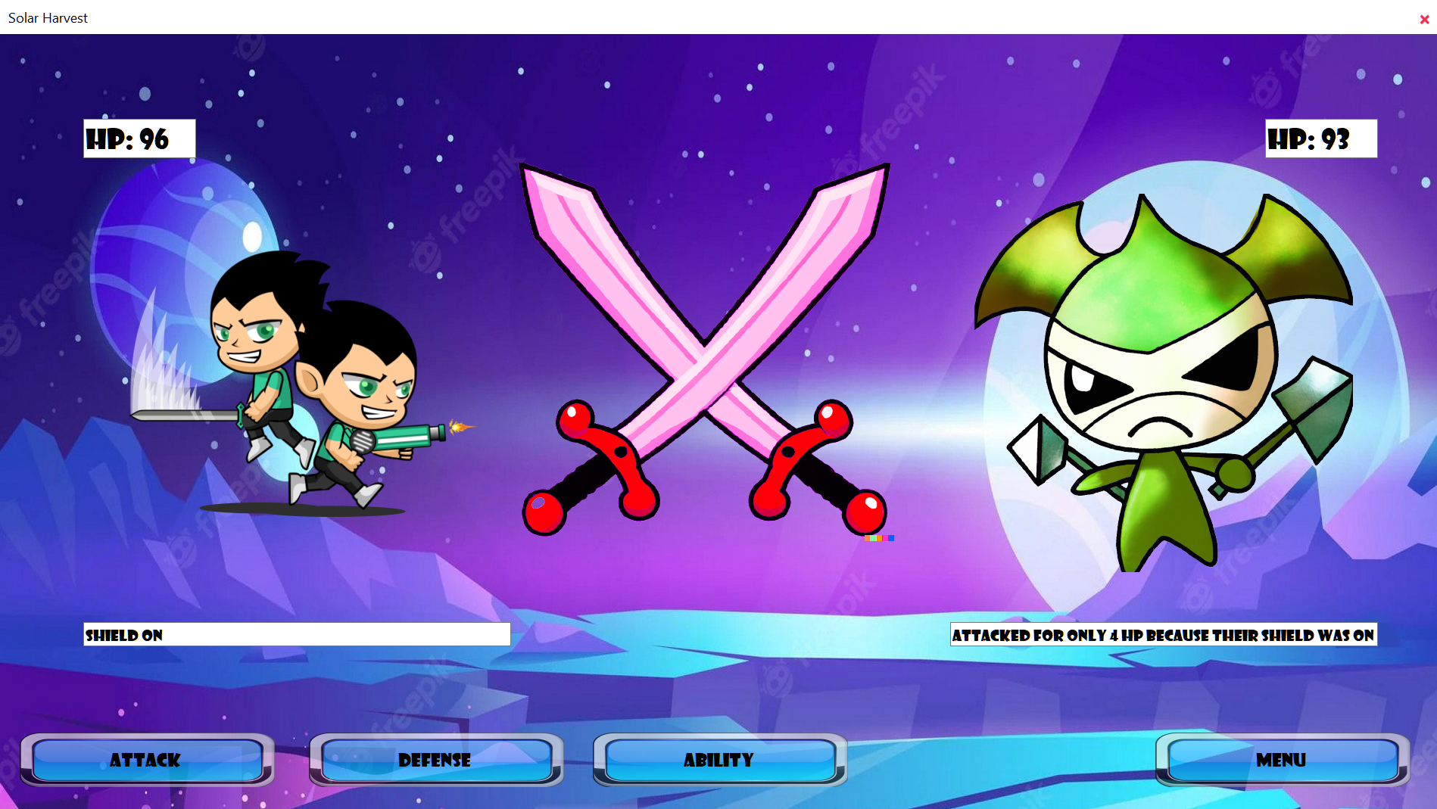
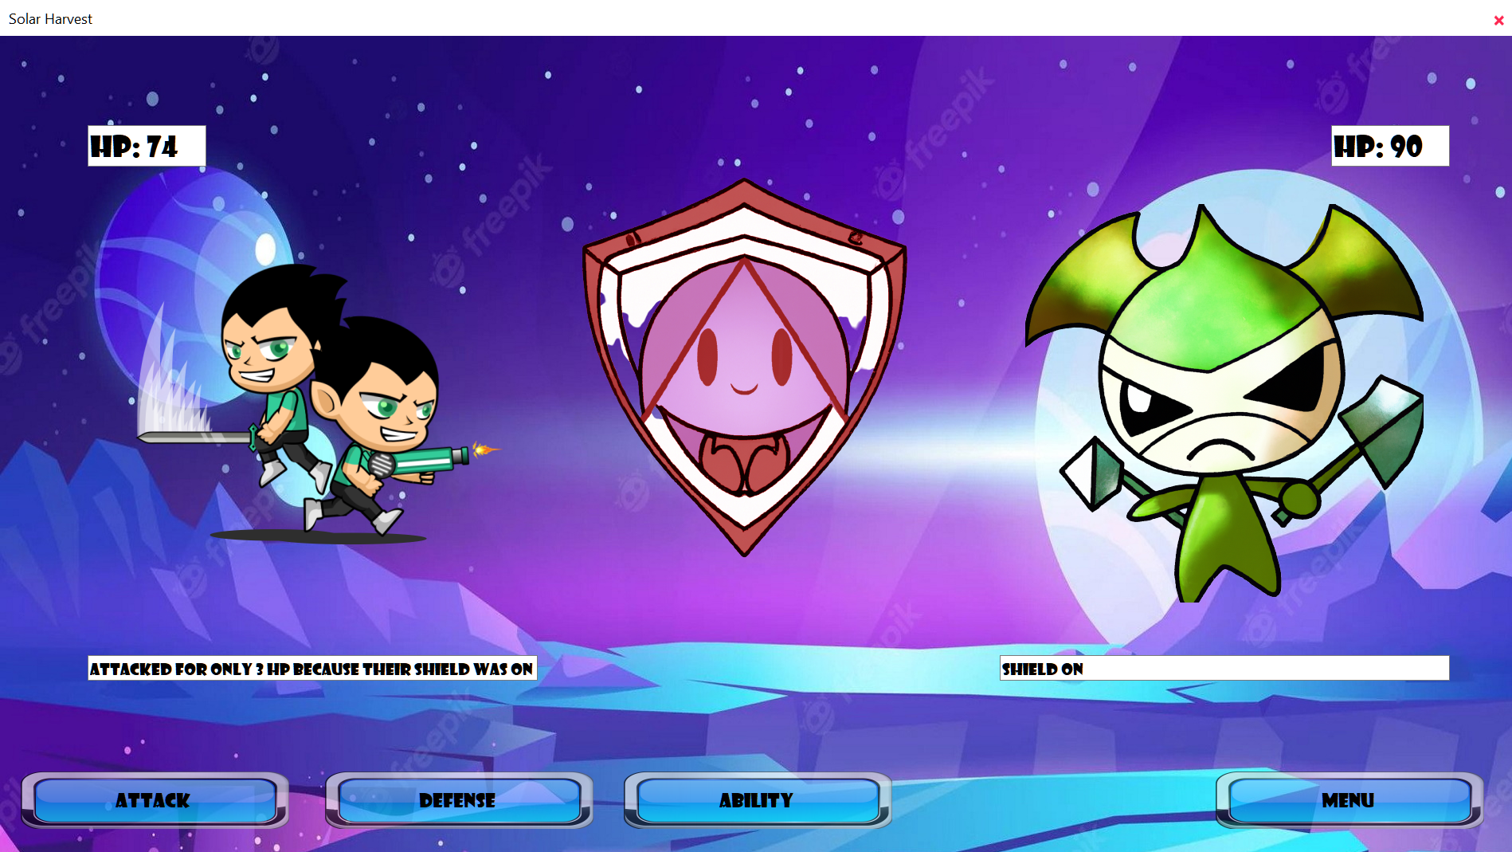
Enemy Actions
The enemy does not have abilities. It only has Attack and Defense, which he activates randomly, except when it’s shield it’s already on, it will only attack.
The enemy action buttons are like the User’s but they are more of a reddish colour.

Slide 8
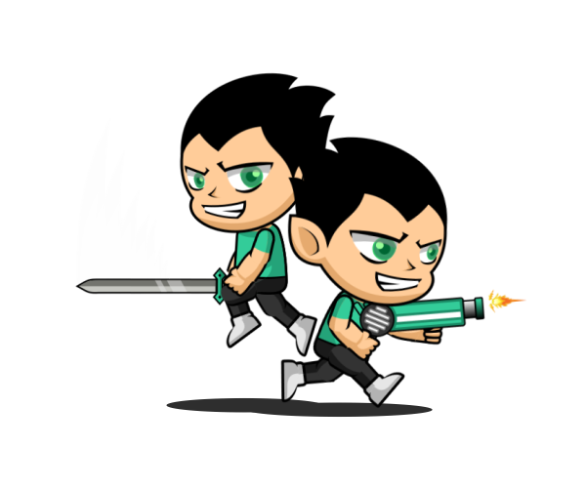
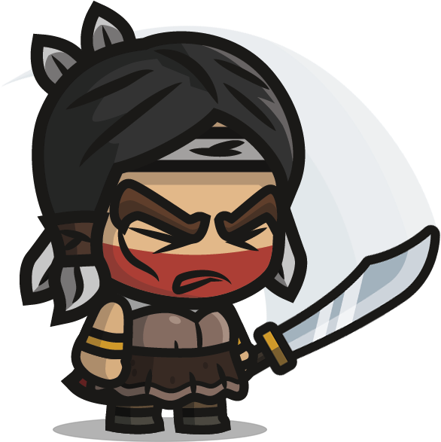
Meet the Heroes
Each hero has it’s own Special Ability.
Aiden & Ethan
removes enemy’s defense and deals double damage, but you take half of the normal damage
Anwir
heals 10 HP, can overheal (get more than the max HP [100])

Slide 9



Peteplank
Will put up defense and attack at the same time, the cost for this ability is to lose 5 HP
Yamato
attacks 3 times consecutively, but for each attack he receives half the damage

Slide 10

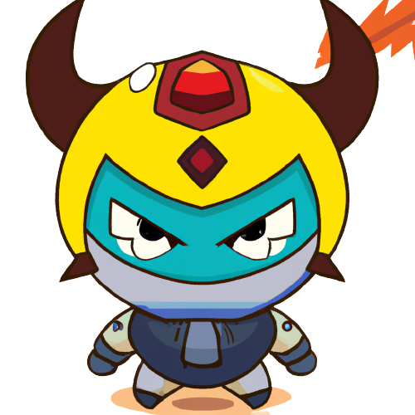
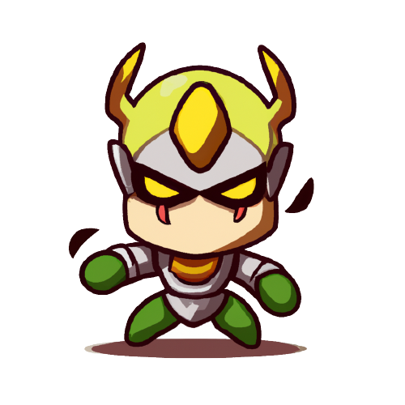

Meet the bosses
Adbaldar Elminster
Atlantes Radagast

Slide 11
Ending the game
The game ends after you or the enemy gets to 0 HP.
After that, the Winner will have in it’s Action TextBox WIN and the Loser will have LOSE and buttons will be deactivated until another game will start.
You can start another game by pressing the menu button and choose the same or another map/character and press the start button.

Slide 12
Thank you

